Slide 1
Project 0
Shopping Cart
Christopher Selling

Slide 2
Tech Stack
Scala 2.13 as the primary language
MySQL for database management and access
SBT in IntelliJ

Slide 3
User Commands
Browse
Cart
Add
Remove
Checkout

Slide 4
Browse
Reads from the Store’s Database and displays on screen
Pattern matching by name
Browse by Department

Slide 5
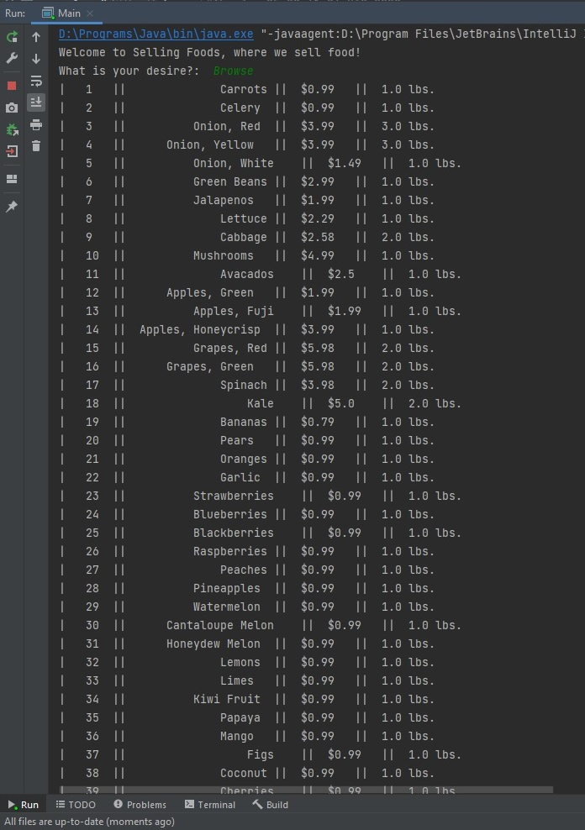
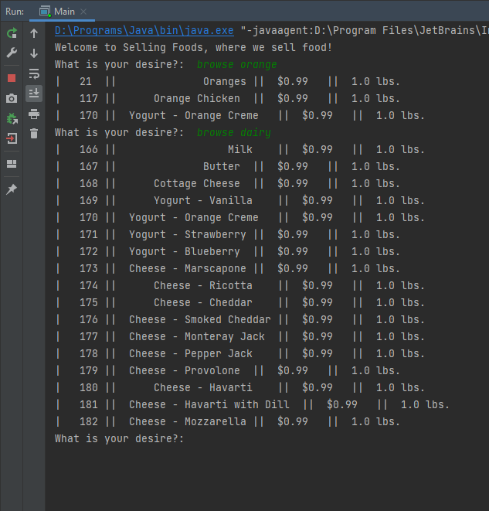
Browse

Slide 6
Cart
Lets the user view his cart
Cart is stored in the database
Cart remains populated between sessions

Slide 7
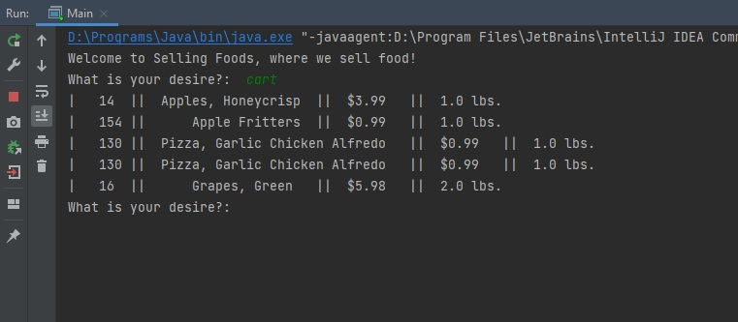
Cart

Slide 8
Add
Adds the selected item to the shopping cart
Done via itemID
Can have duplicate items in the cart

Slide 9
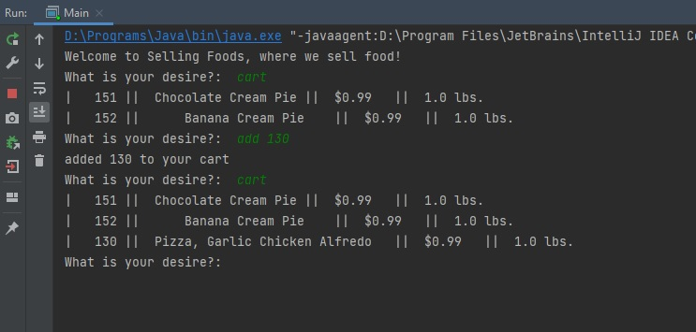
Add

Slide 10
Remove
Removes the selected item from the cart
Done via itemID
Removes only one copy

Slide 11
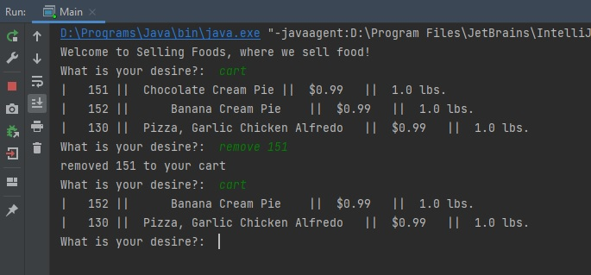
Remove

Slide 12
Checkout
Displays the total cost of the shopping cart
Removes all items from the shopping cart

Slide 13
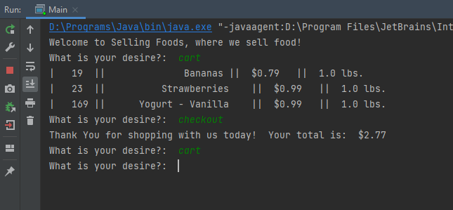
Checkout

Slide 14
Thank You
Thank you for your time
Christopher Selling

